Slide 1

Financial Dashboard
Alice Degonzague
30th November, 2022

Slide 2
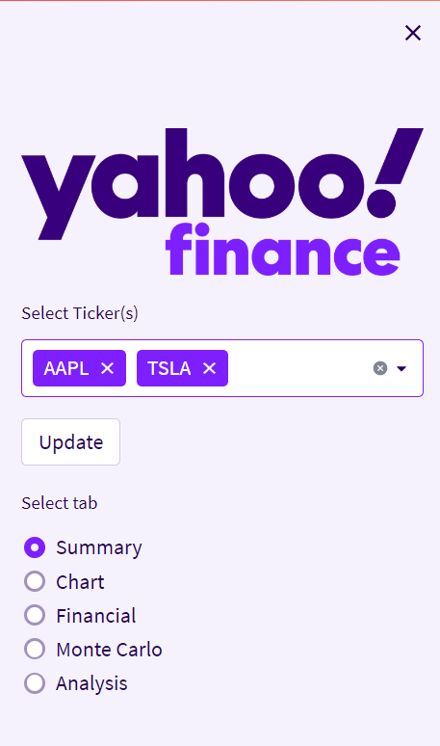

01. Sidebar

Slide 3
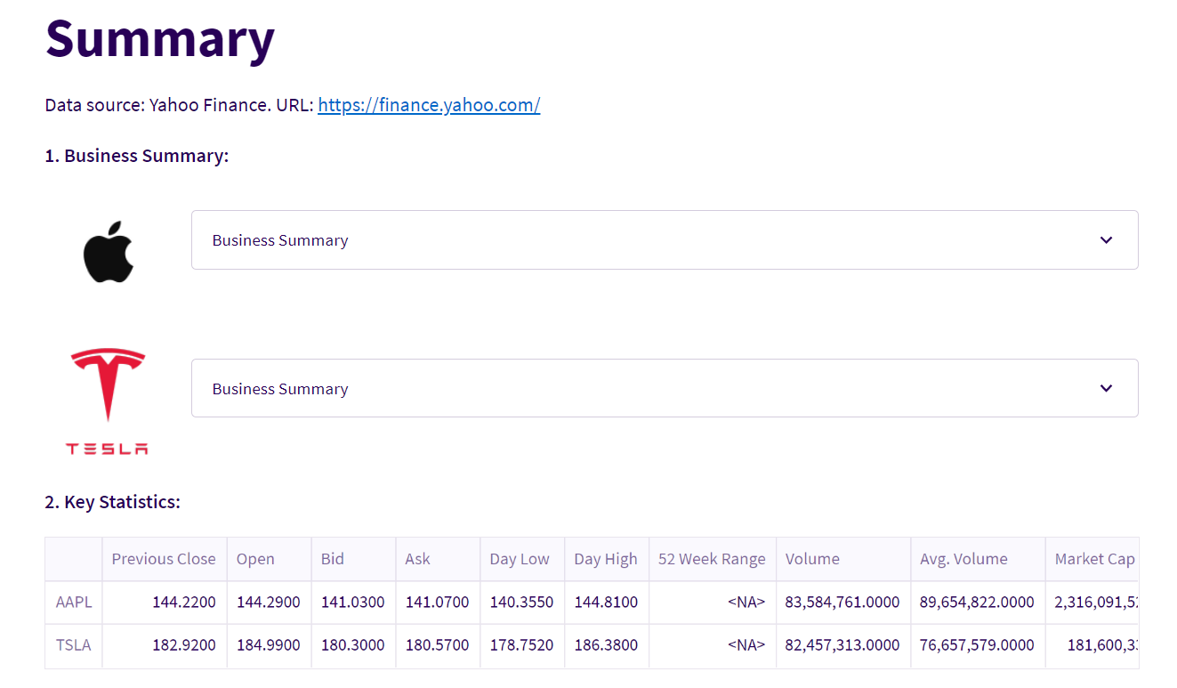
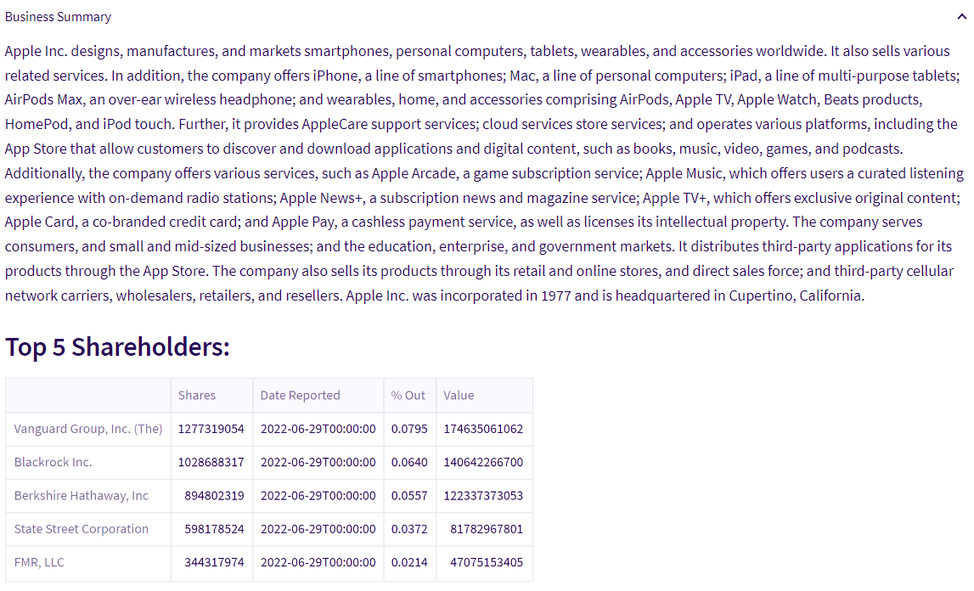
02. Summary
You can enter a subtitle here

Slide 4
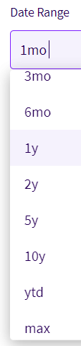
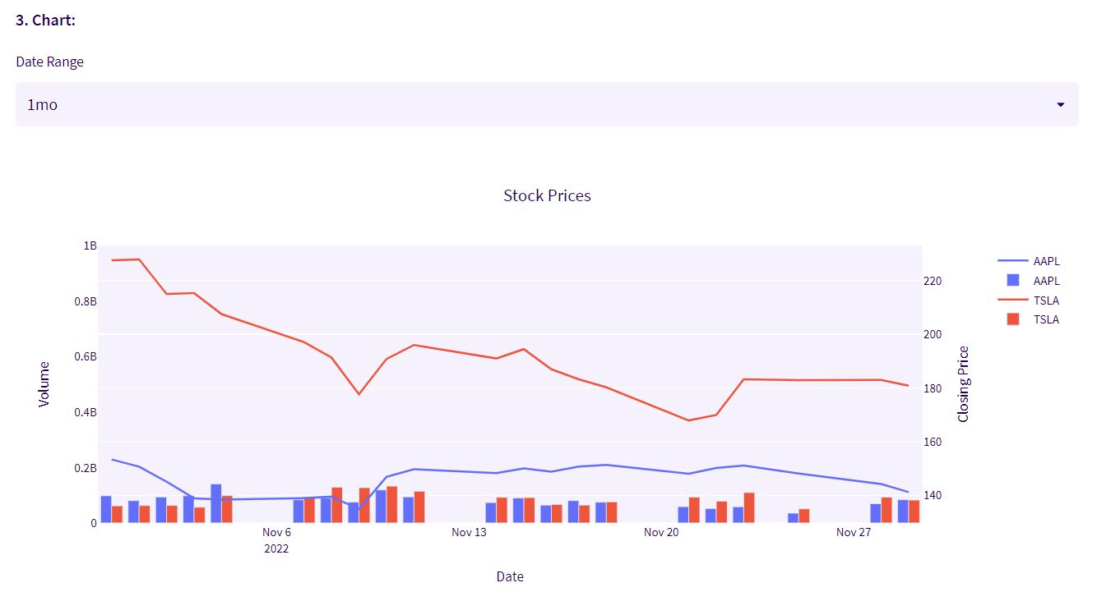
02. Summary

Slide 5
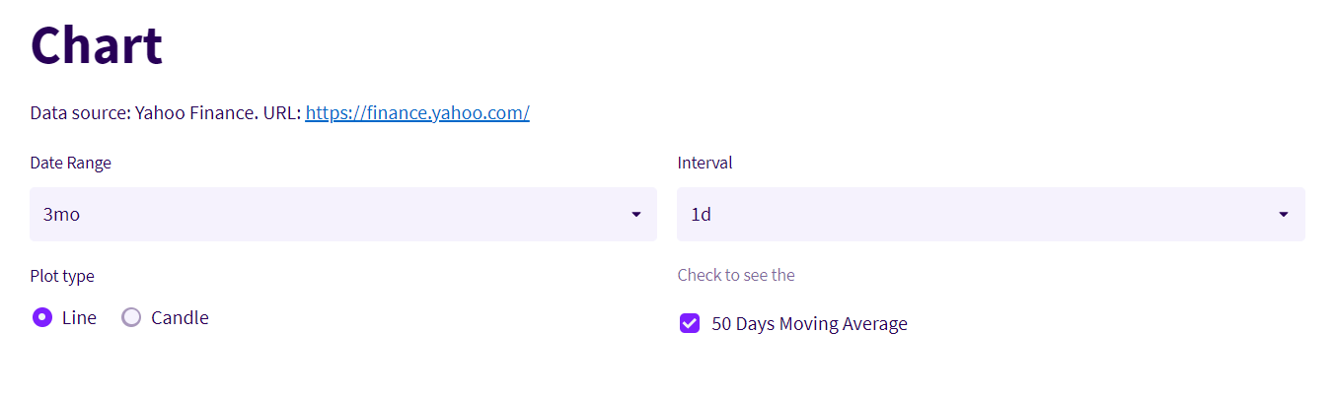
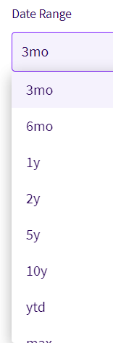
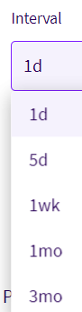
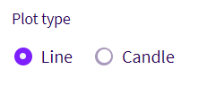
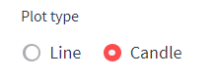
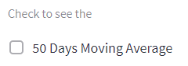
03. Chart

Slide 6
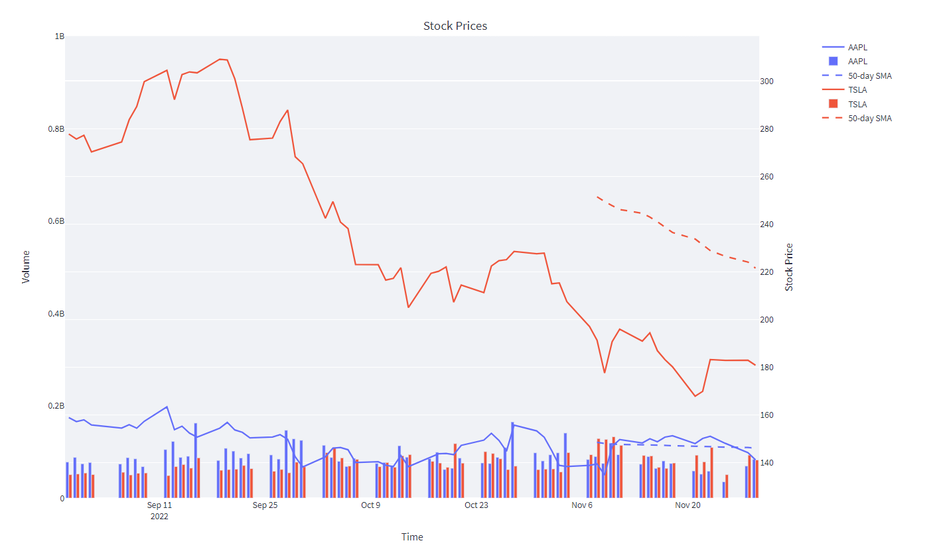
03. Chart

Slide 7
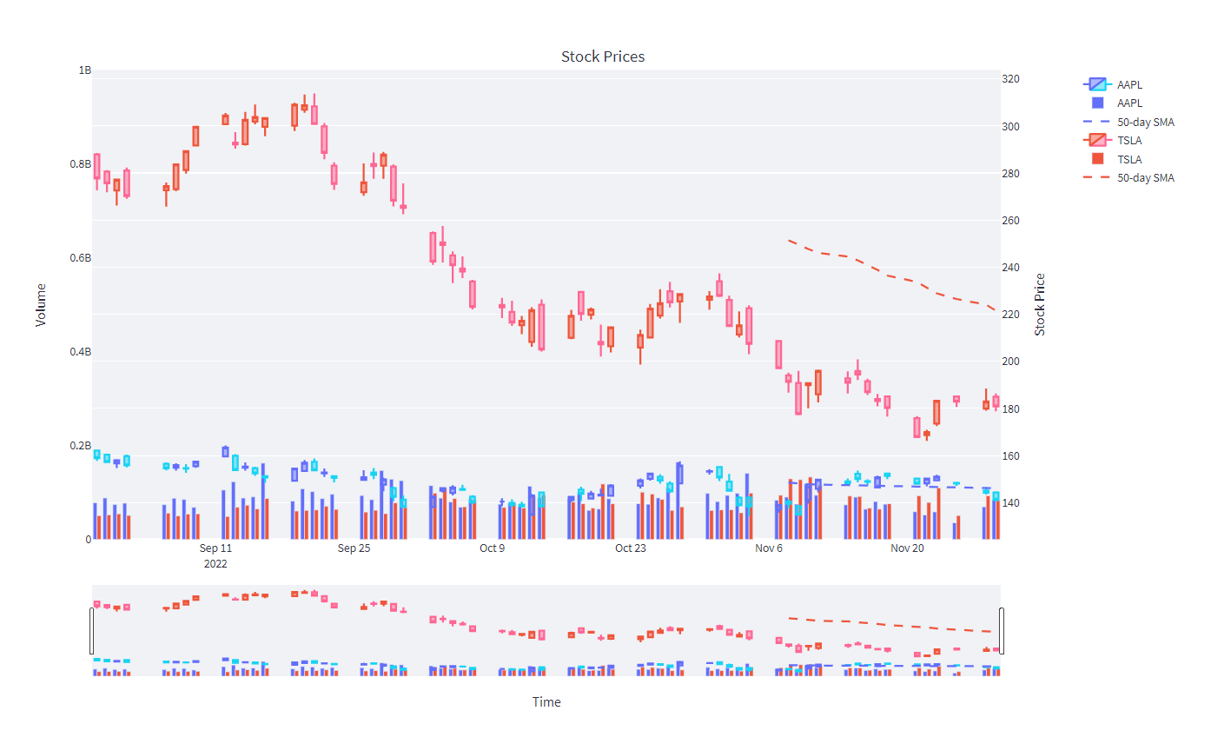
03. Chart

Slide 8
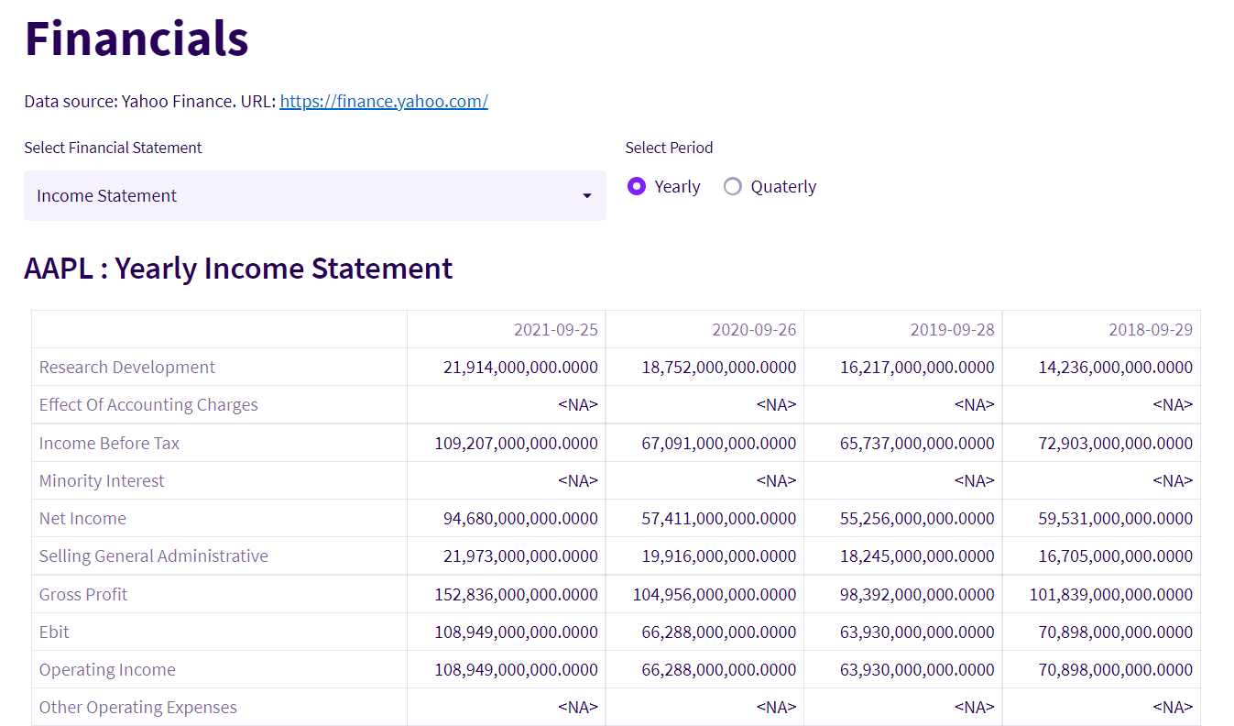
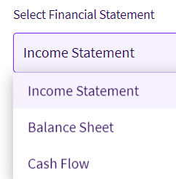
04. Financials

Slide 9
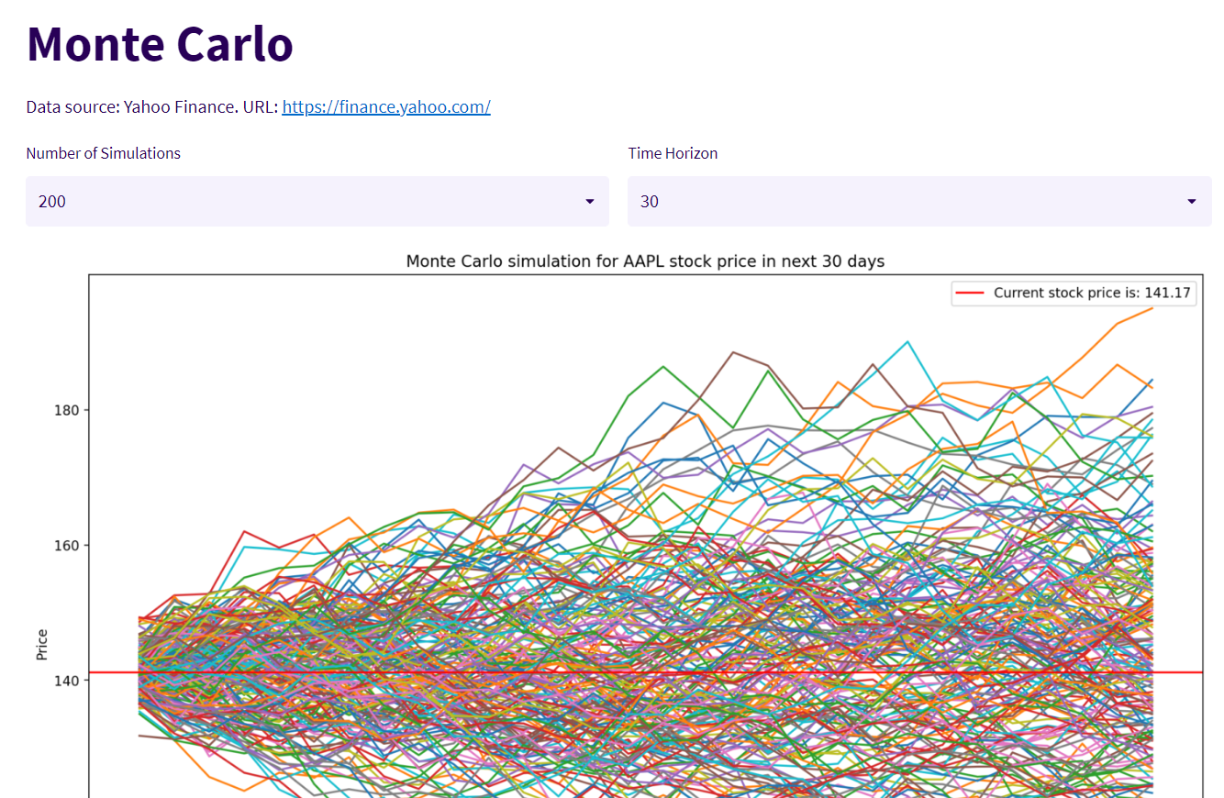
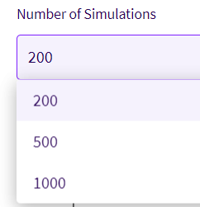
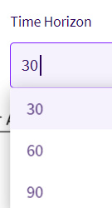
05. Monte Carlo

Slide 10
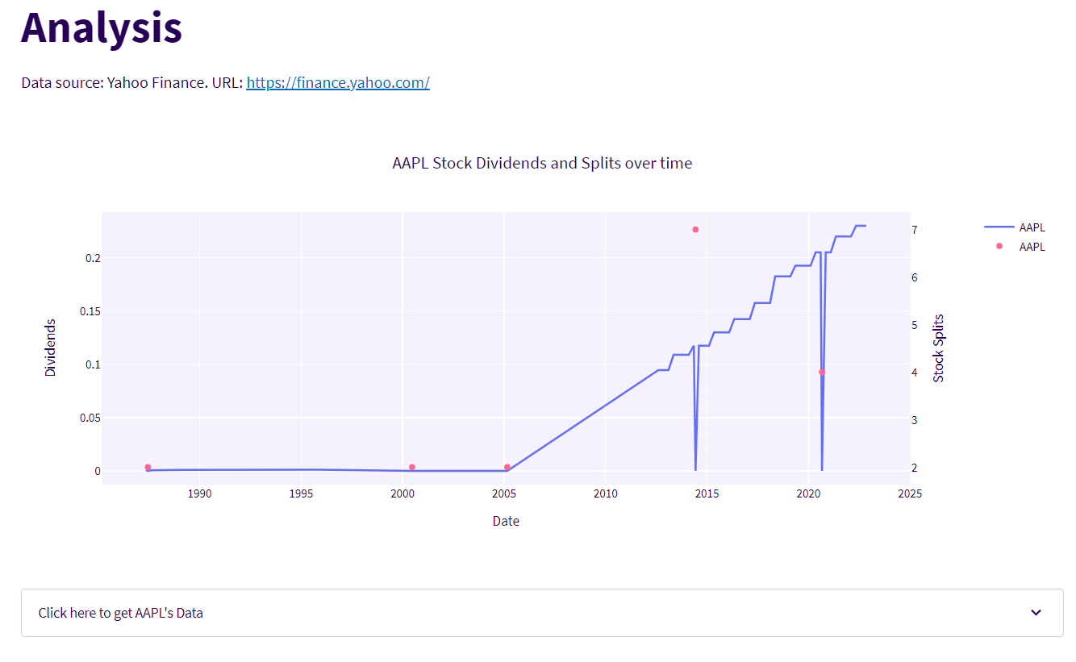
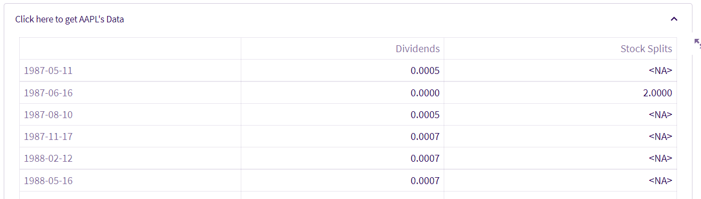
06. Analysis

Slide 11
References
Function GetStockData: Section 4
Function MonteCarlo: Section4
https://plotly.com/python-api-reference/generated/plotly.graph_objects.Scatter.html
https://community.plotly.com/t/apply-color-groups-for-multiple-traces/59950/2
https://python.plainenglish.io/building-a-simple-stock-screener-using-streamlit-and-python-plotly-library-a6f04a2e40f9
https://plotly.com/python/candlestick-charts/
https://analyzingalpha.com/yfinance-python
https://pypi.org/project/yfinance/
https://docs.streamlit.io/library/advanced-features/theming
https://docs.streamlit.io/library/api-reference/control-flow/st.experimental_rerun
I might have forgotten the thousands of forums I visited to correct my code, adapt the format of some columns, plot with pyplot and matplotlib…

Slide 12
THANKS
Find the link to my dashboard here:
https://adegonzague-financial-dashboard-strea-financialdashboard-js5a8i.streamlit.app/

